Slide 1


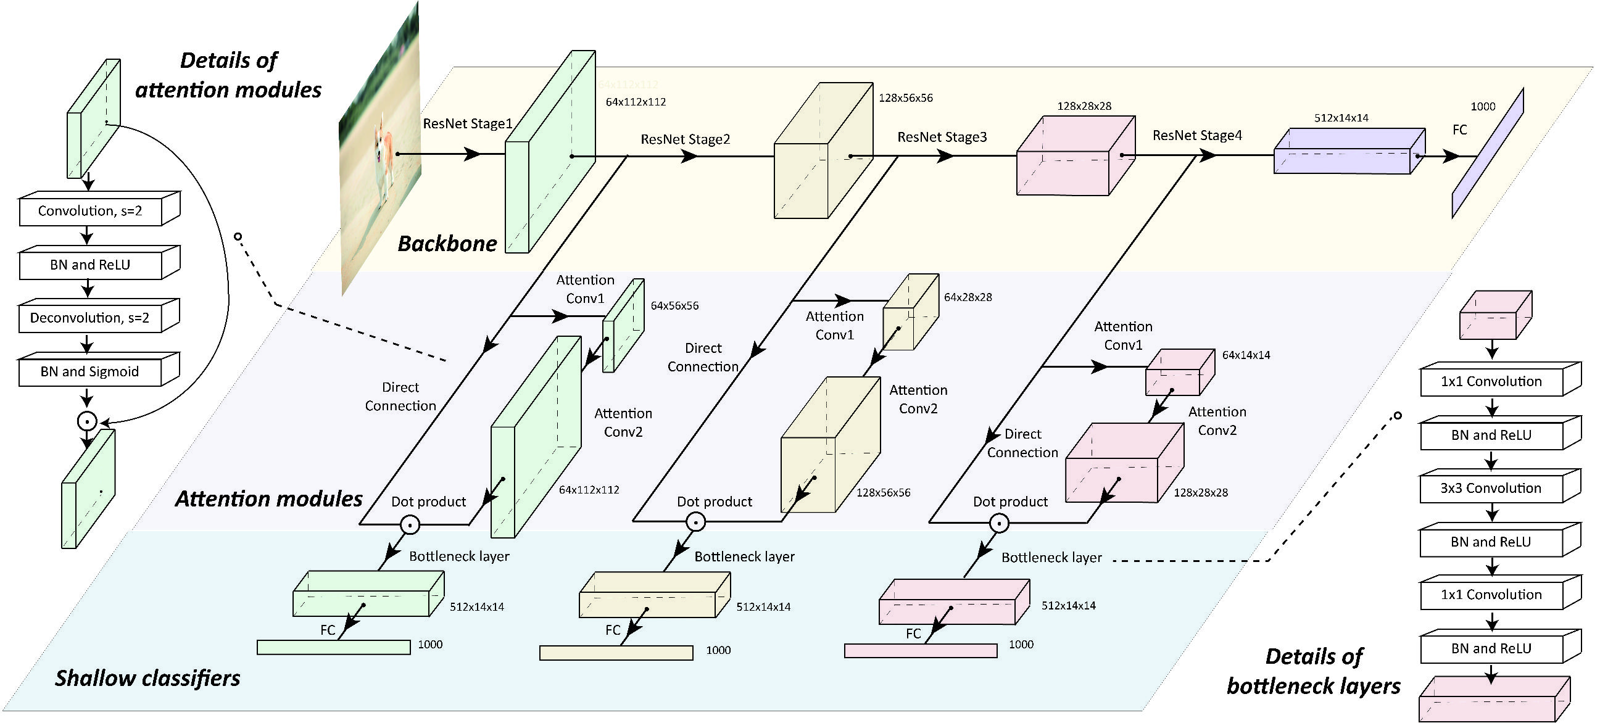
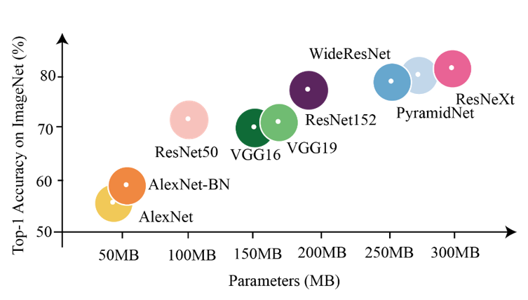
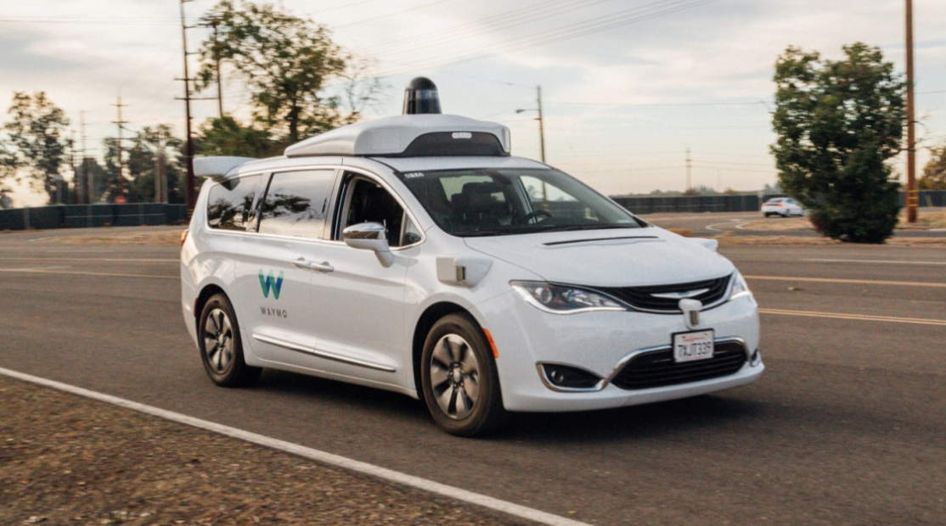
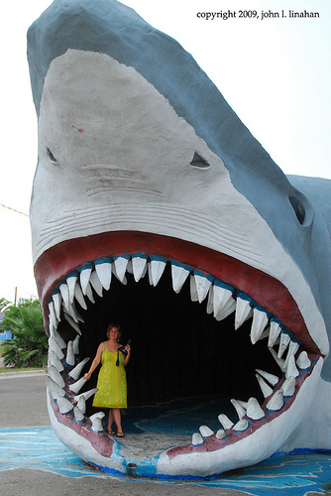
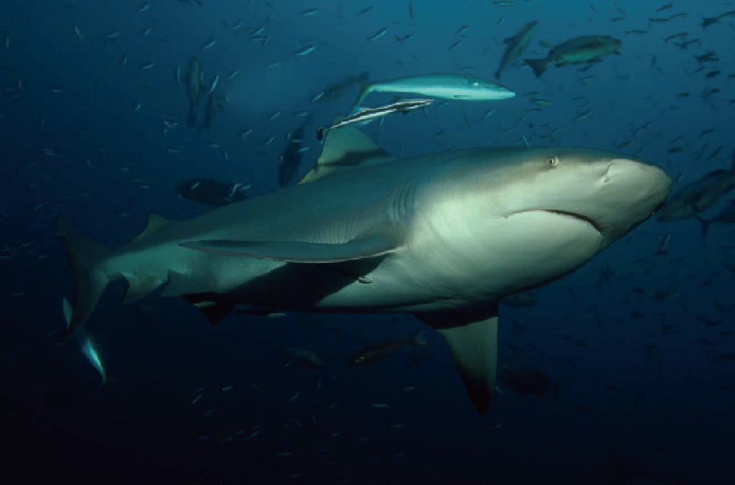
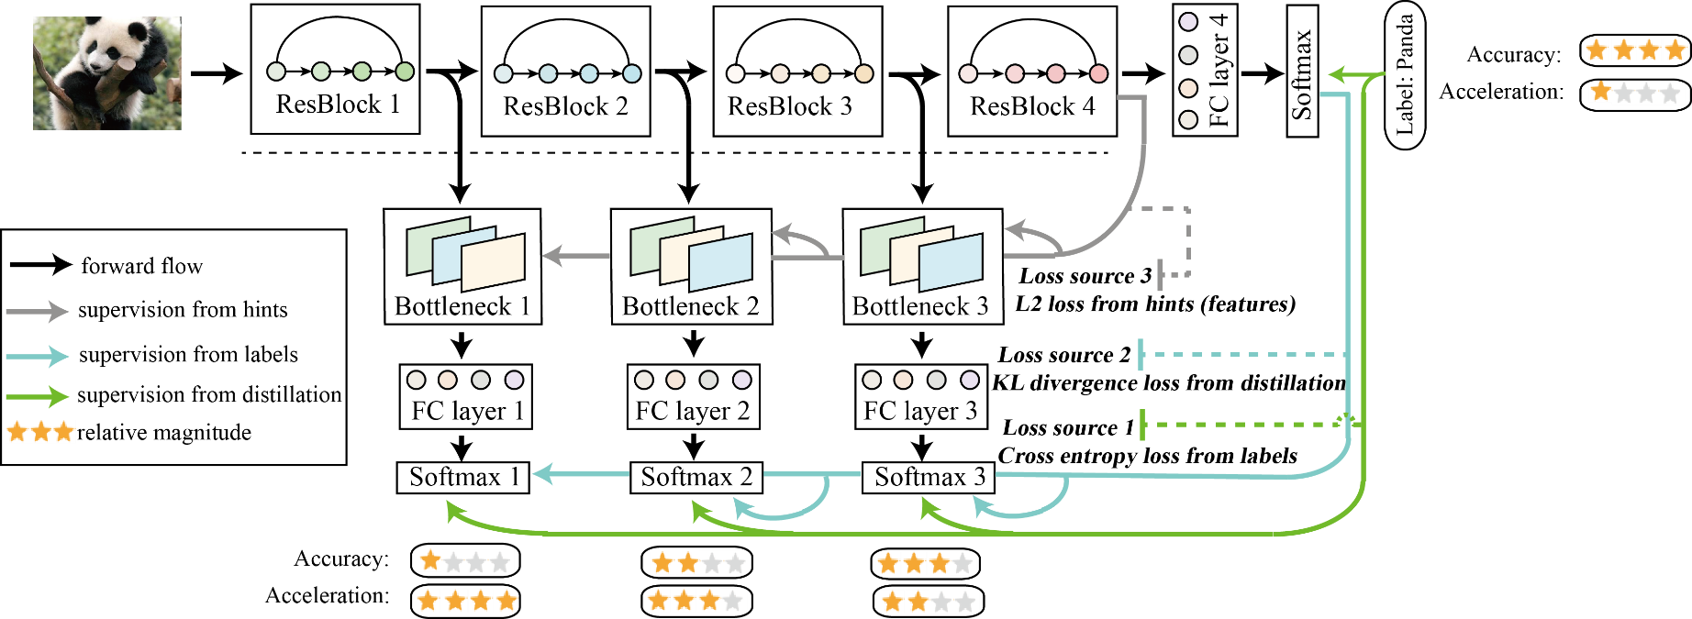
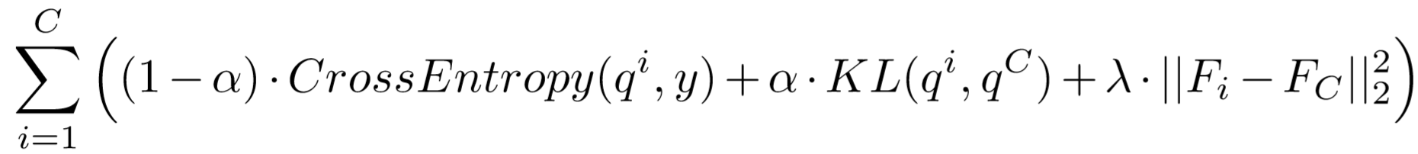
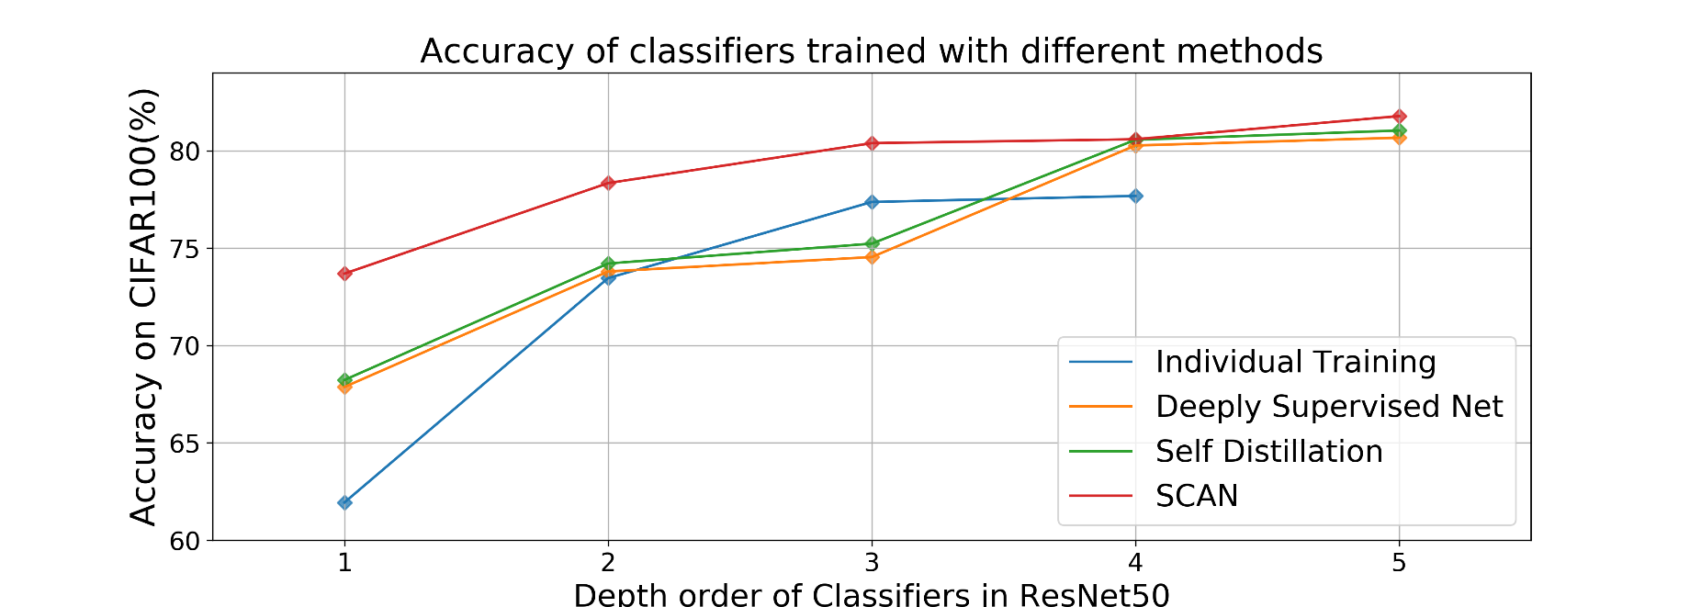
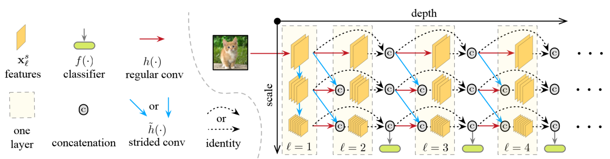
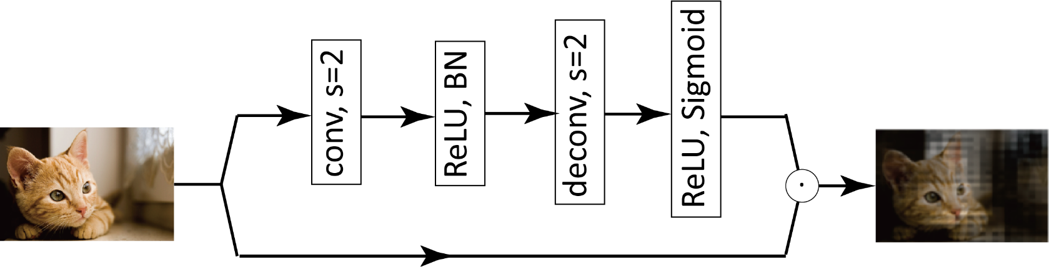
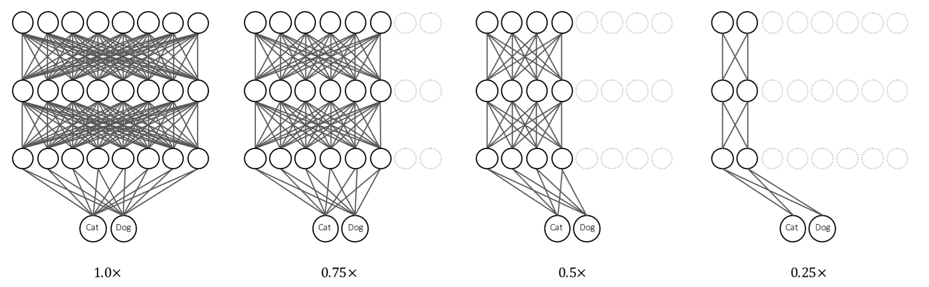
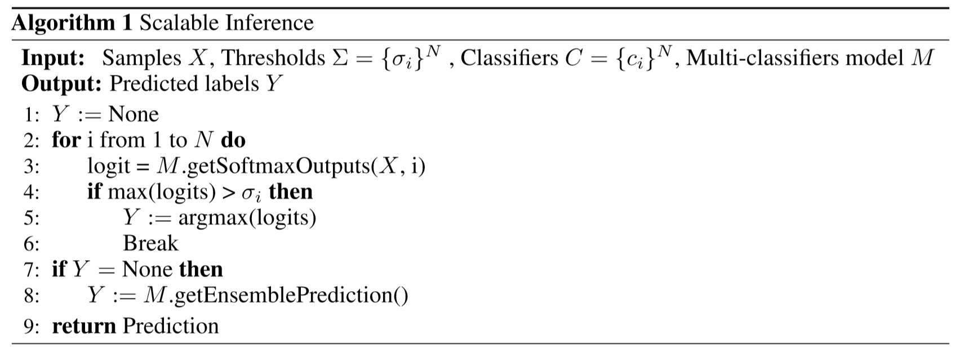
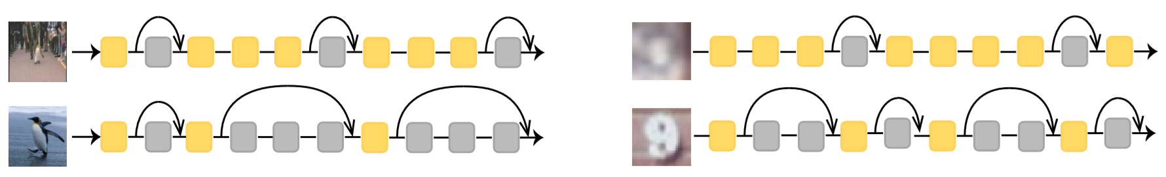
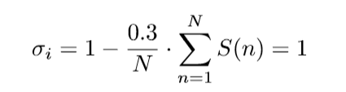
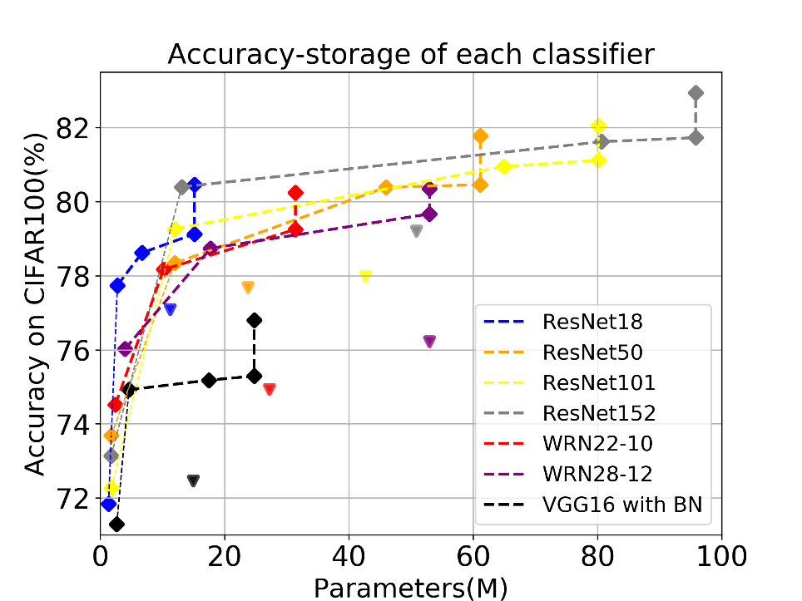
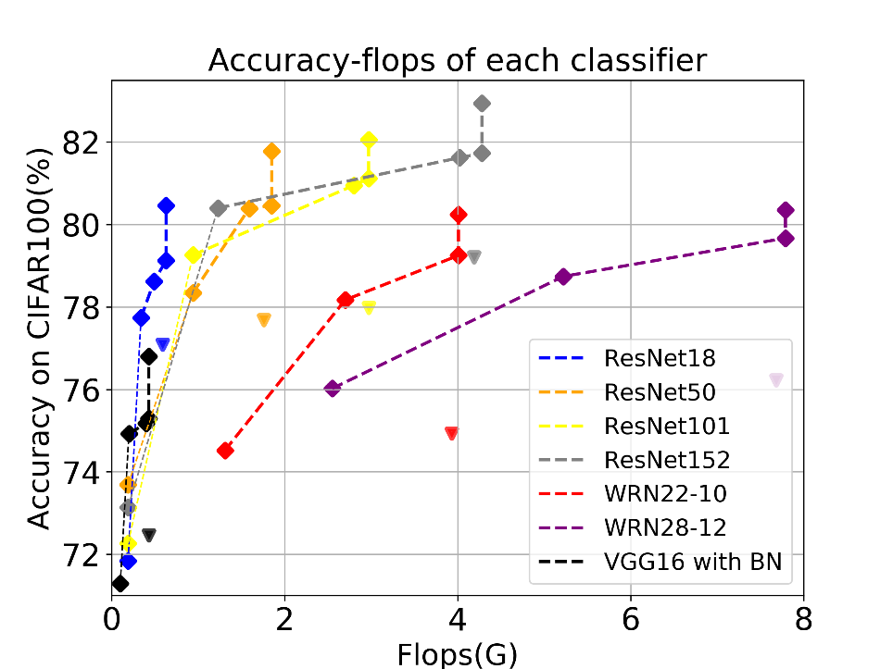
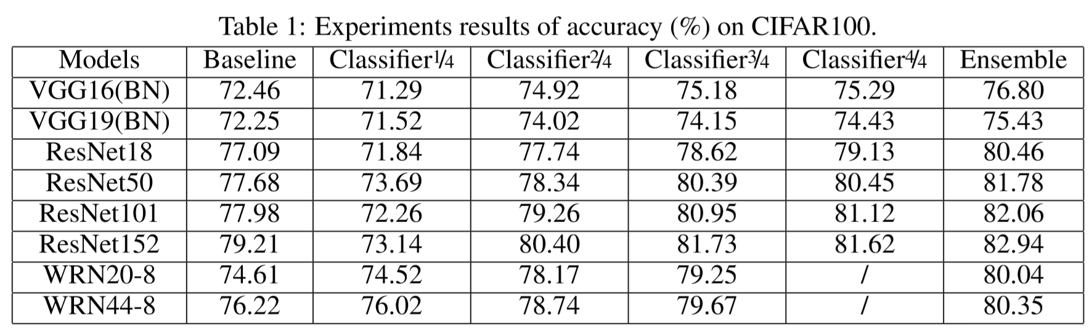
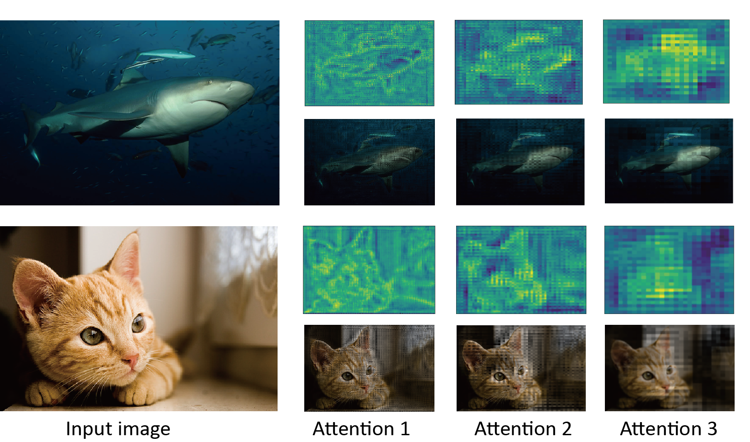
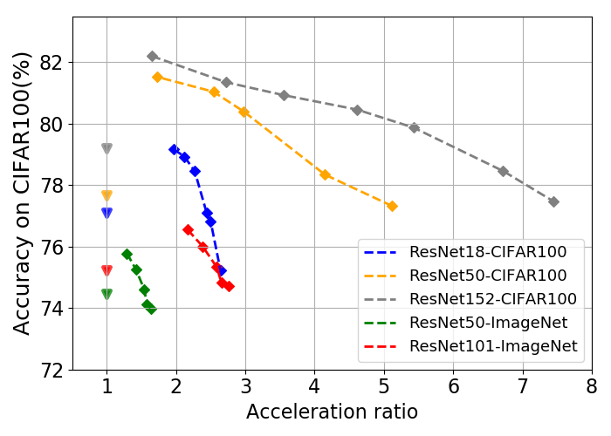
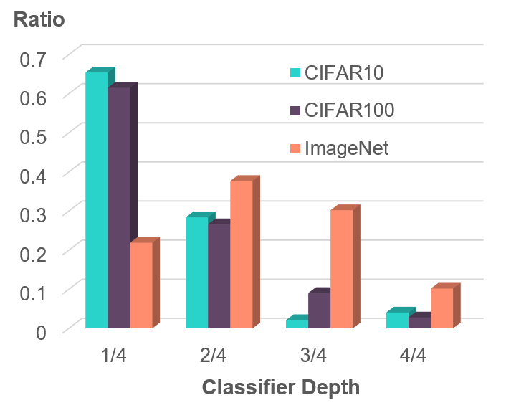
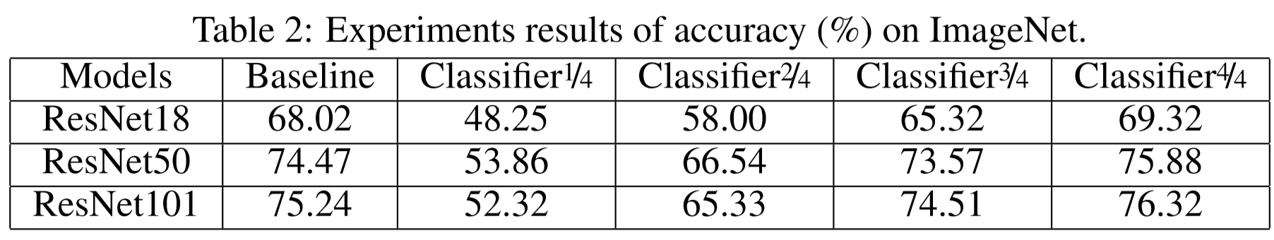
SCAN: A Scalable Neural Networks Framework Towards Efficient And Compact Models
Linfeng Zhang, Zhanhong Tan, Jiebo Song, Jingwei Chen, Chenglong Bao, Kaisheng Ma
Background
Proposed SCAN
We need to compress and accelerate deep neural networks models for their deployment.
DNNs achieves higher accuracy at the expense of explosive growth in parameters and computation.
Applications like self driving cars have limited computation resource but demand real-time response.
Motivation
The architecture of ResNet18 equipped with SCAN: (i) The whole neural networks can be divided into three sections: backbone, attention modules and shallow classifiers. (ii) The backbone section is just identical to the origin model. (iii) Additional attention modules are attached after the intermediate features of backbone.(iv) Features refined by attention modules will be feed into the shallow classifiers, which consist of a bottleneck layer and a fully connected layer.
These two pictures contain a shark. For human beings, the classification of the left image (which is confusing) requires more consideration compared with the right image.
Self distillation in SCAN
The shallow classifiers architecture and training methods in self distillation are utilized to train small models.
In self distillation, each shallow classifier is constructed by a bottleneck layer and fully connected layer, trained by distillation, which can be formulated as
However, different from human perception, computer vision systems treat the two images with the same time.
We should build a model like human perception, which can classify easy samples with less computation !
Attention modules in SCAN
However, the accuracy of each classifier in self distillation and similar multi-exits neural networks remain to be improved.
Related Work
As is shown in the figure, nearly 12% and 7% accuracy drop can be observed on the first and second classifiers in self distillation.
MSDNet: Build shallow classifiers upon different scale features.
Problem: Limited with DenseNet. Low accuracy.
Propose attention modules in SCAN is composed of one convolution layer for downsampling and one deconvolution for upsampling.
A sigmoid layer is attached after them to obtain attention factor from 0 to 1. Then, a dot production is brought about to get the attention enhanced features.
Xin Wang, Fisher Yu, Zi-Yi Dou, Trevor Darrell, and Joseph E Gonzalez. Skipnet: Learning dynamic routing in convolutional networks. In ECCV, pages 409–424, 2018.
Scalable Inference Mechanism
Slimmable NN: Train a NN which works with arbitrary channels.
Problem: Computation of different width can not be shared.
We further propose scalable inference mechanism, which exploit all the classifiers in neural networks at the same time.
With scalable inference mechanism, easy samples will be predicted by shallow classifiers, leading to dramatic acceleration.
Jiahui Yu, Linjie Yang, Ning Xu, Jianchao Yang, and Thomas Huang. Slimmable neural networks. In321 ICLR, 2019
Searching for thresholds
Then, accuracy and acceleration are taken into consideration to define the fitness for genes.
SkipNet: Skip some layers in neural networks.
Problem: Not friendly to hardware.
Then, to find the optimized thresholds in scalable inference, we further propose a genetic algorithm to search for thresholds.
Gao Huang, Danlu Chen, Tianhong Li, Felix Wu, Laurens van der Maaten, and Kilian Q Weinberger.283 Multi-scale dense networks for resource efﬁcient image classiﬁcation. In ICLR, 2017.
Firstly, we define an equation for decoding genes into thresholds.
Adjustment of β leads to trade-offs between accuracy and acceleration.
Experiments
All the classifiers pay their attention on the same spatial position - the bodies of a shark and a cat, while ignoring the backgrounds.
Shallow classifiers pay more attention to the local and high frequency features, while deep classifiers pay more attention to global and low frequency features.
The squares connected in the same line from left to right denote the classifier 1/4 to classifier 4/4 and their ensemble. The triangle with the same color out of lines denotes the corresponding baseline.
As shown in Table 2: On average, 1.26% accuracy gain on ImageNet can be achieved, varying from 1.41% on ResNet50 as maximum to 1.08% on ResNet101 as minimum.
In all the situations, the classifier2/4 equipped with SCAN outperforms its baseline. 2.17X acceleration and 3.20X compression have been achieved on average with no accuracy drop.
On average, 4.41X and 1.99X acceleration can be achieved with no accuracy drop on CIFAR100 and ImageNet, respectively.
This figure shows the statistics of samples predicted by each classifier of three datasets with the same thresholds.
More accuracy gain can be observed on deeper neural networks which is in accordance with the general observation that over-parameterized models have more potential to be compressed and accelerated.
More than half samples in CIFAR can be classified in the shallowest classifier.
In ImageNet, more samples have to be predicted in the last two classifiers

